Slide 1
SpaDES: Spatial Discrete Event Simulation
R package for powerful, fast, scalable simulation
Alex M. Chubaty
Eliot J. B. McIntire

Slide 2
Forecasting
We need to forecast the past, present and future of ecosystem properties
We need to either understand these systems, or at least come up with phenomenological relationships
We have or will get data, whose magnitude is growing fast (“Big Data”)
What is the number one system for understanding data

Slide 3

R
R is the most comprehensive and powerful language for understanding and predicting from data

Slide 4
Why R?
Free, open source, cross-platform
Tight link between simulation and data analyses (allows for optimization)
Very good for GIS and spatial analyses

Slide 5
Why R?
Highly flexible and scalable
Fast, performant code execution
Huge user support and help community

Slide 6
Why R?
High level delivery:
Building static and dynamic reports
Including interactive websites
Visualization is very mature
Can package standalone executables
e.g., for Windows end-users

Slide 7
Three levels of user in applied ecological sciences
Clients
Polished deliverable
E.g., government, industry, etc.
Scientists
Understand data
Create new questions
More or less skilled at coding
More power at fingertips = more questions can ask
Developers
E.g., computer programmer, off-the-shelf software

Slide 8
R as the unifier
R addresses all of these user levels:
Polished, professional, publishable reporting and visualization tools
Scientists gain access to low-level power through high-level functions
Fast development time for programmers

Slide 9
The SpaDES package for R
Spatial Discrete Event Simulation
Integrate modules that have a concept of time, and where the module is “interruptible” at particular times
Goal: to integrate existing and not yet built simulation modules to ask new policy questions?

Slide 10
Integrated questions require integrated solutions
Given that spruce budworm is rampant, what are the forecasts for central Quebec in 10 years for:
Caribou?
Jobs?
Carbon?
Etc.
This can’t be answered by a single group
Need to join the caribou, economic, fire, climate, and carbon modules to the spruce budworm module.
Notes:
We can’t build a massive model of everything – and we don’t want to! Our goal is to integrate expert-built models in a common platform.

Slide 11
Integrated modelling approach
Evaluate models as hypotheses
Estimate uncertainty
Ensemble forecast modelling
Study cumulative effects
Feedbacks and interactions between modules

Slide 12
SpaDES: objectives and motivations I
Rapid model development for wide variety of model types (IBMs, matrix, etc.)
Faster, more memory efficient, more scalable, than current systems (e.g., NetLogo, SELES, Repast, etc.)
Capitalize on R’s strengths as a data manipulation and data analysis platform
Notes:
Simulation models are essentially data manipulation combined with data analysis.

Slide 13
SpaDES: objectives and motivations II
Be open source and make it easy to contribute modules and code
Be easy to use for scientists who aren’t formally trained as programmers
Allow tight coupling of models and data
Built around modularity so that models can be seen as modules that are easily replaceable (not just “in theory”)

Slide 14
SpaDES: design overview
agents
simulation
parameters
modules
data
maps
data
maps
variables
“internal”
module
schedule
event
model
“external”
module
event queue
file
outputs
timer
screen
outputs
process event

Slide 15
SpaDES: module overview
Description of all possible module events:
Event type (e.g., init, move, plot)
What happens during processing the event
Modules can be user-modified or user-built
Minimize module interdependencies to maintain modularization

Slide 16
SpaDES: demo
randomLandscapes
fireSpread
caribouMovement

Slide 17
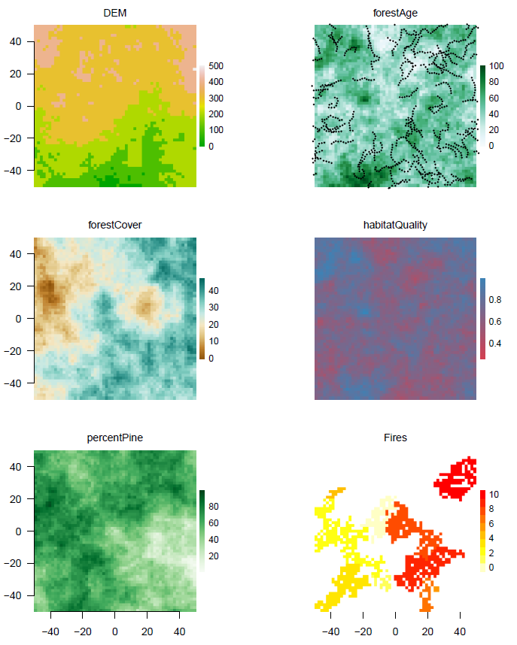
Maps:
Digital elevation model
Forest age
Forest cover
Caribou habitat quality
Percent pine
Current fire locations
Caribou movement trajectories plotted on forest age map

Slide 18
stats for caribou/fires per Eliot’s example in vignette

Slide 19
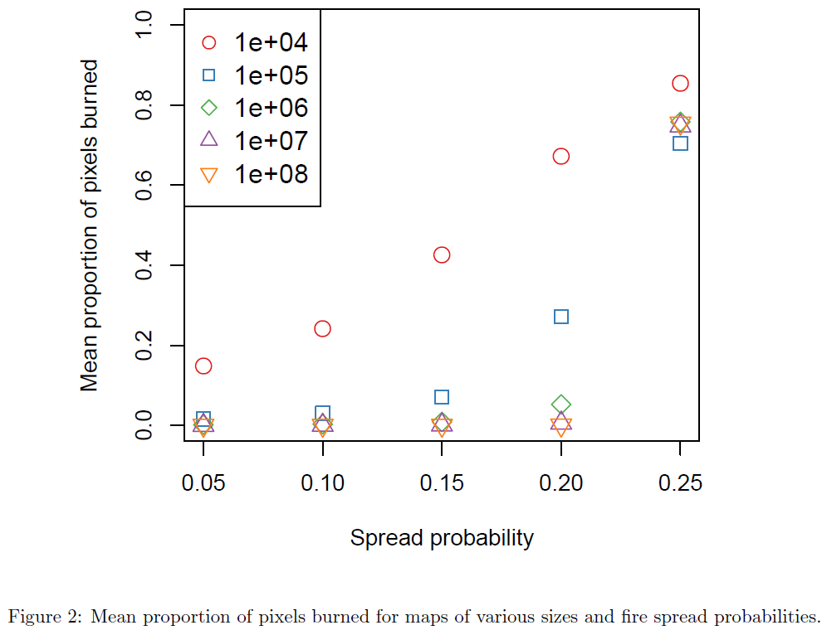

Slide 20
SpaDES: shiny demo
caribouMovementLcc
fireSpreadLcc
forestAge
forestSuccession
NOTES
-- currently branded for ISA
-- 100,000 pixels in central SK
-- confirm the veg types / colors in maps

Slide 21
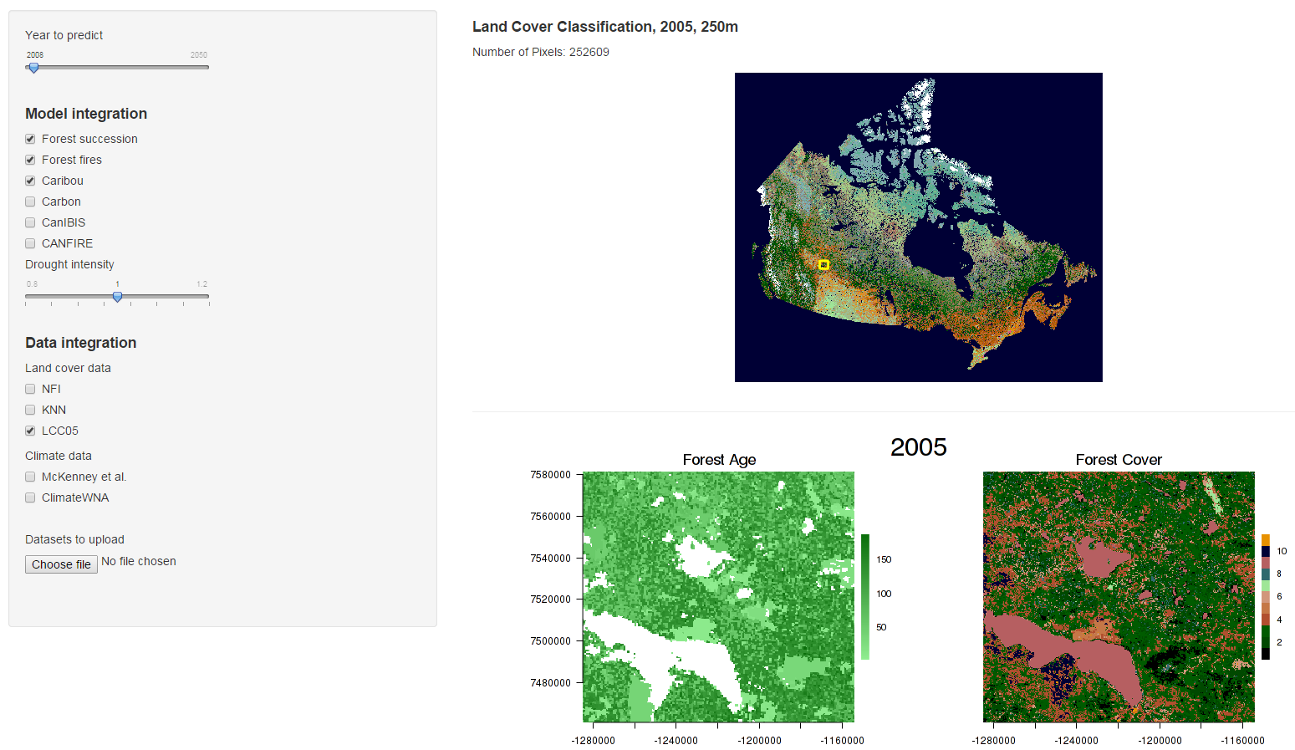

Slide 22
Current active developers
Alex Chubaty
Eliot McIntire
Steve Cumming

Slide 23
Module collaborators
Mountain pine beetle dispersal
Alex Chubaty (PFC/Laval)
Fire spread
Steve Cumming (Laval)
Boreal forest succession and regeneration
Yong Luo (PFC/fRI/Laval)
Caribou movement and habitat use
Sarah Bauduin (Laval)

Slide 24
Planned collaborators
CFS:
Carbon Accounting Team
Assistant Deputy Minister Innovation Fund & ISA
Boisvenue, Shaw, Cooke, Campbell,
Private sector:
Colin Daniel (ApexRMS)
Foothills Research Institute (Healthy Landscapes)
University:
UBC - Nicholas Coops, Val Lemay

Slide 25
Research collaborators
Eliot McIntire (PFC/Laval)
Jill Johnstone (Sask)
David Andison (fRI)

Slide 26
https://github.com/achubaty/SpaDES
SpaDES in still a work in progress…BUT
Will eventually add to CRAN
Feedback welcome
Contributions …

Slide 27
Contributions that are needed, I of II
Additional modules
MPB, Fire, Succession, Caribou
New modules
Spruce Budworm, Carbon,
Policy
Risk, Economic forecasts, Planning

Slide 28
Contributions that are needed, II of II
Improving
dependency expressions
Module, data, spatial region, political region
Big data seamlessness
R can handle BIG, but there are many ways to do it; what are the best for each module/situation

Slide 29
https://github.com/achubaty/SpaDES
apexrms
fRI

